Slide 1


Dev-Pro Node.js
Advanced Flow
Lesson 3. Streams.

Slide 2

Agenda:
What is the stream
Type of streams
Streams events
Piping
fs module

Slide 3


Slide 4

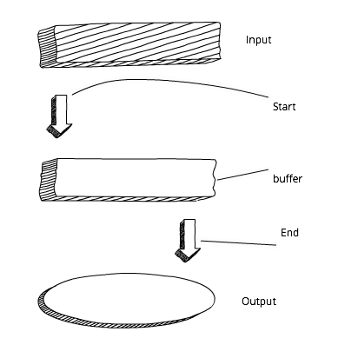
What is the stream?

Slide 5
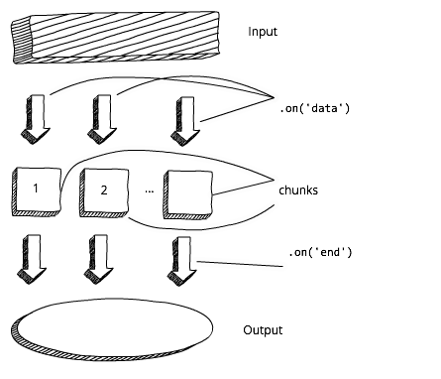
What is the stream?

Slide 6

What is the stream?

Slide 7
What is the stream?

Slide 8
What is the stream?

Slide 9
Stream types

Slide 10
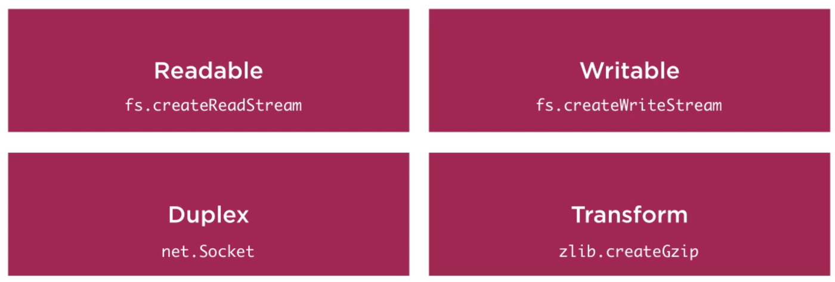
Stream types

Slide 11
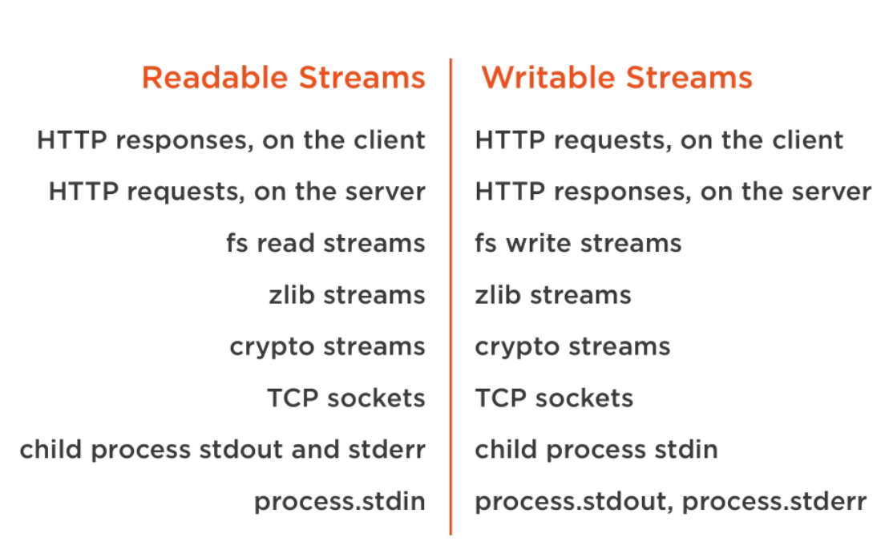
Stream types

Slide 12

Something about streams…

Slide 13

Piping

Slide 14
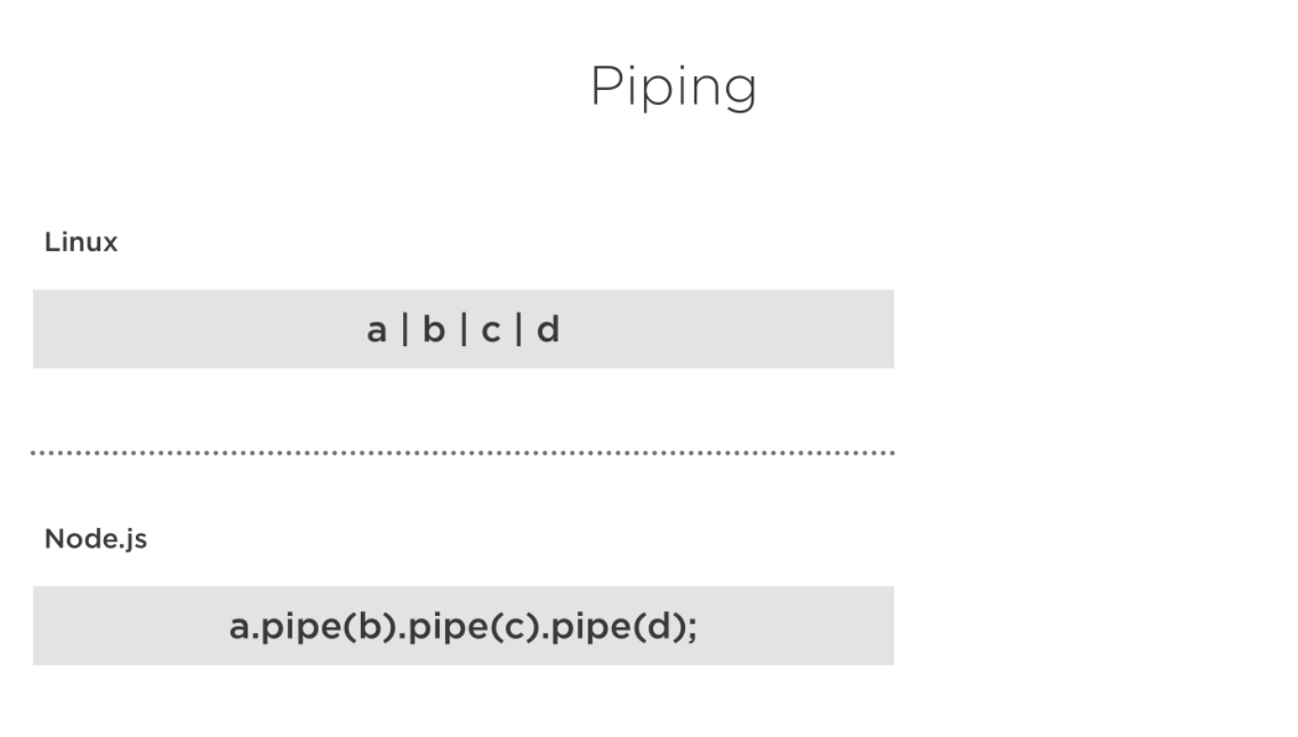
Piping

Slide 15
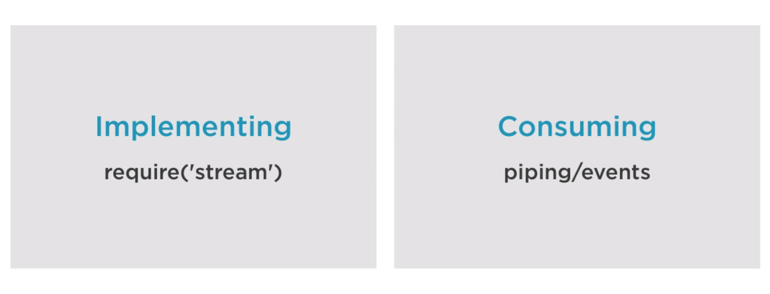
Piping

Slide 16
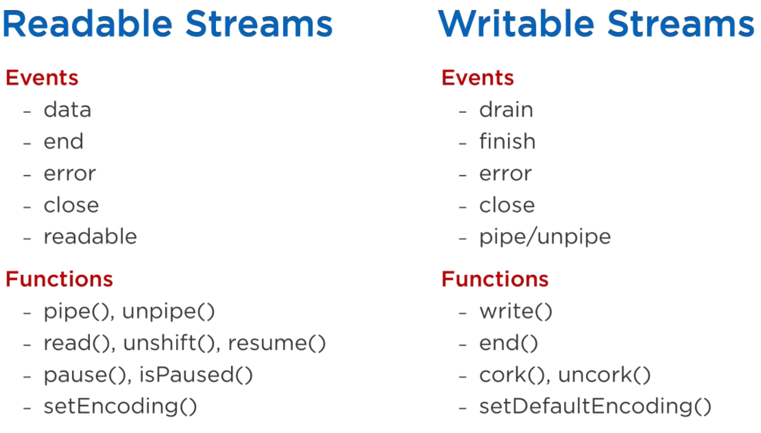
Readable/Writable streams

Slide 17
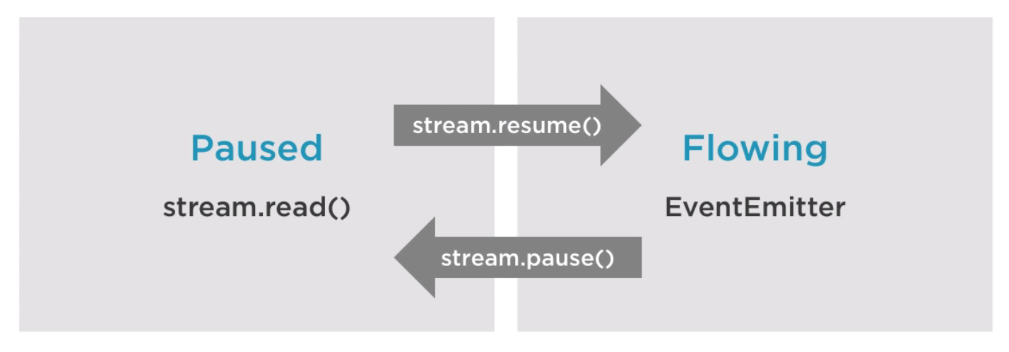
Readable streams

Slide 18
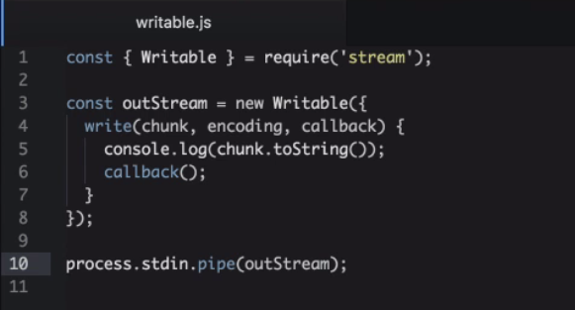
Writable streams

Slide 19
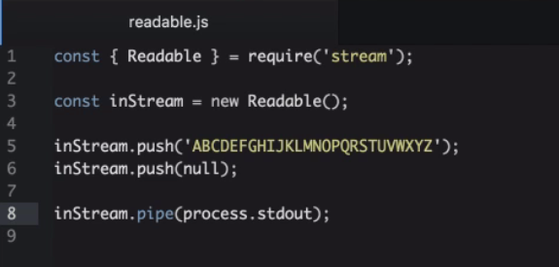
Readable streams

Slide 20
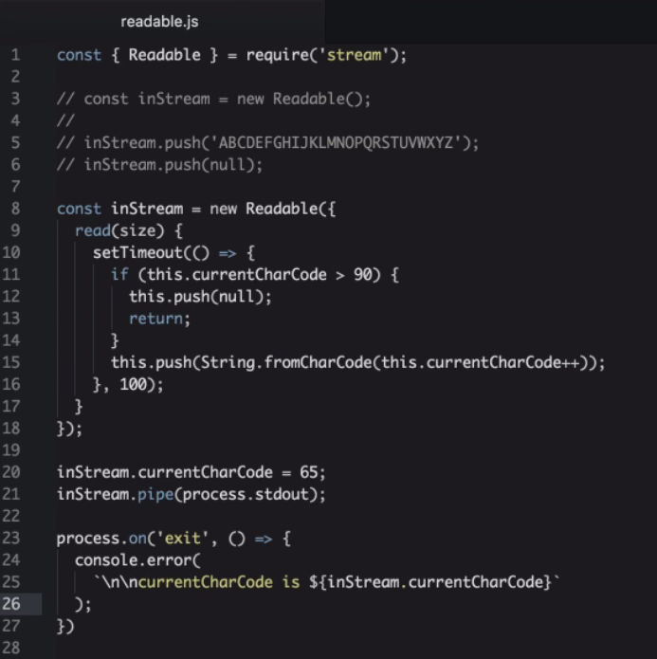
Readable streams

Slide 21
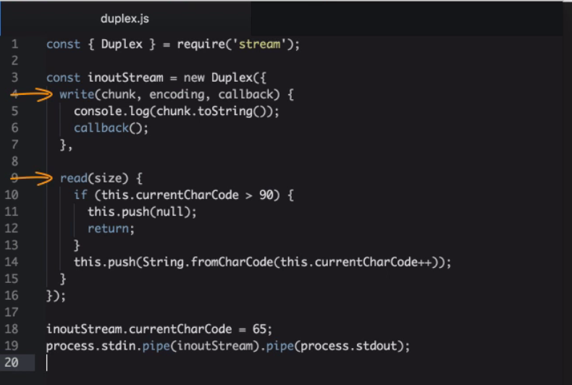
Duplex streams

Slide 22
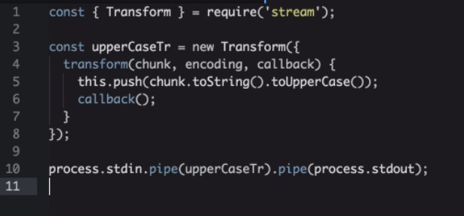
Transform streams

Slide 23
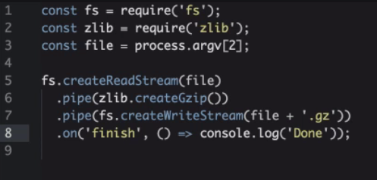
Transform streams - zip

Slide 24
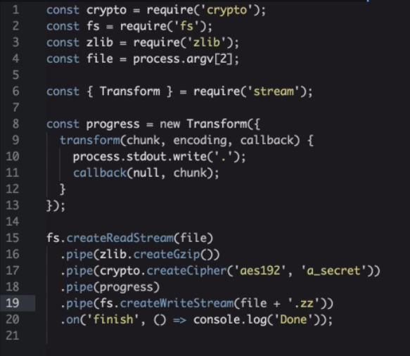
Transform streams - encrypted zip

Slide 25

Mocking the require

Slide 26
Thank you for attention

